Slide 1
Medium-term Precipitation Projections with Neural Networks
The Search for Insights into the Phenomenology of Drought and El Nino Conditions
Justin Le, Schmid College of Science and Technology

Slide 2
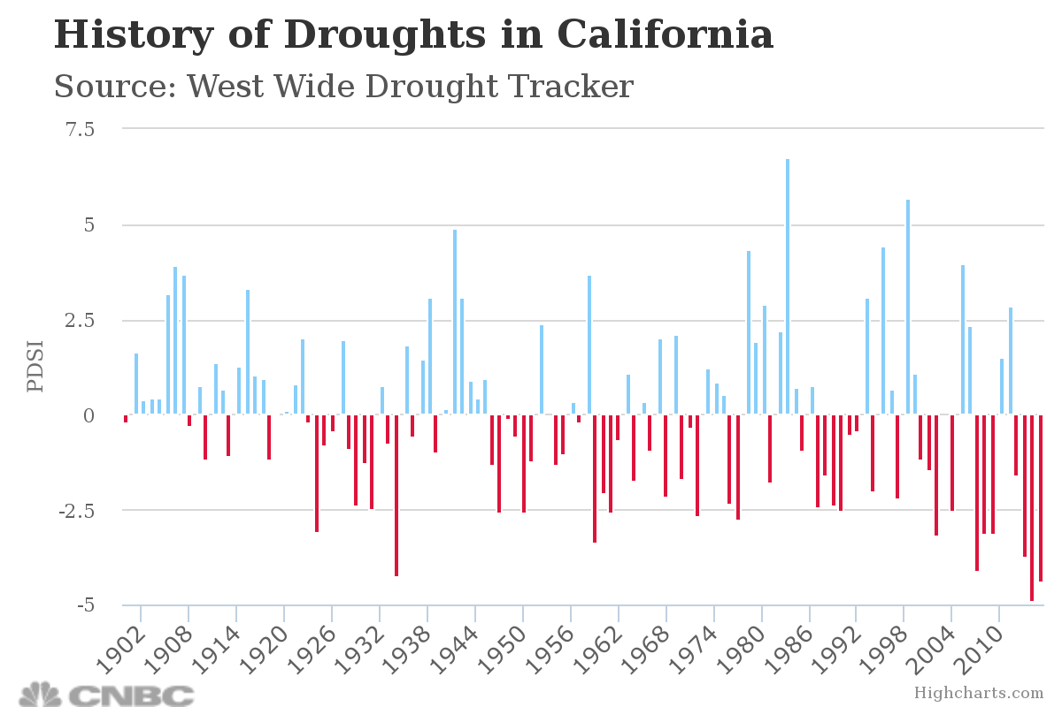
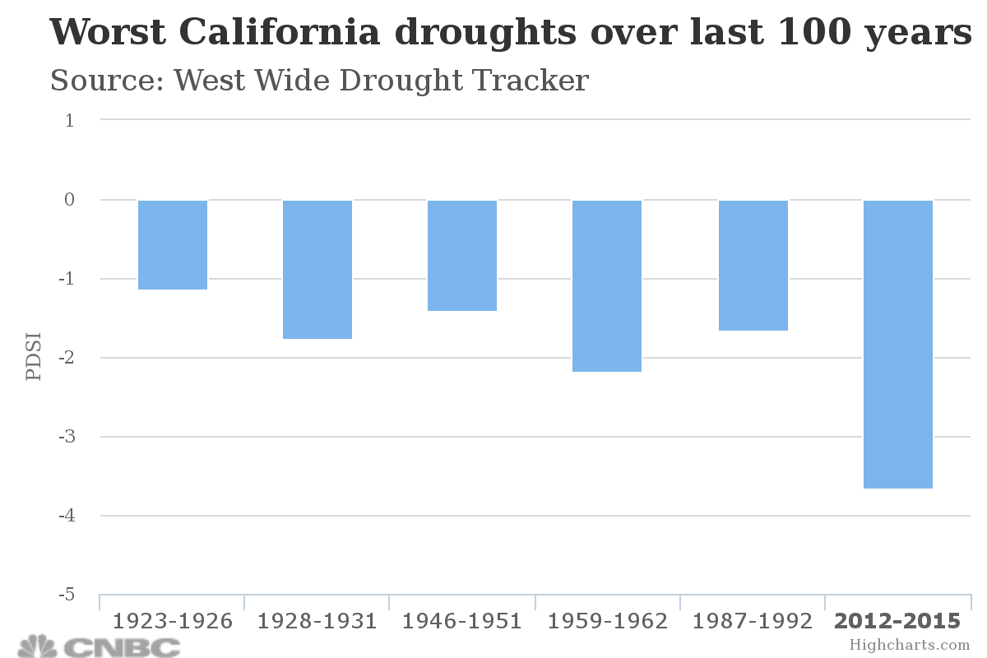
California Drought

Slide 3
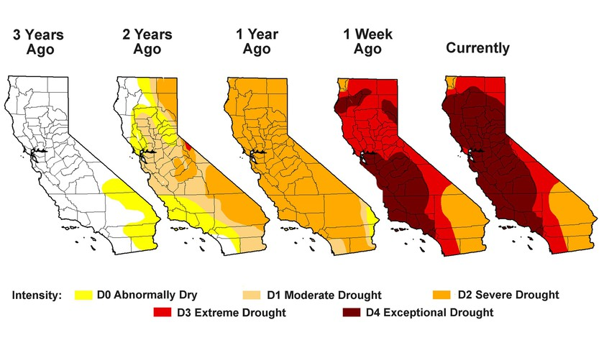
California Drought

Slide 4
Environmental Impacts of Drought
Short-term:
Detriments to Hydropower production and recreation
Low farm yields
Long-term:
Groundwater storage lost
Food and water shortages
Over-pumping can cause permanent groundwater loss, land elevation sinking, and seawater intrusion
Wildfire risks
2015 drought season estimated to have cost more than $2.2 billion in economic loss.

Slide 5
El Nino
Global periodic phenomenon linked to high ocean temperatures near South American coast
In California, manifests as a season of extreme rainfall, flooding, and warm temperatures.
1997-1998 El Nino Season is estimated to have caused $25 billion in damages to the entire country.

Slide 7
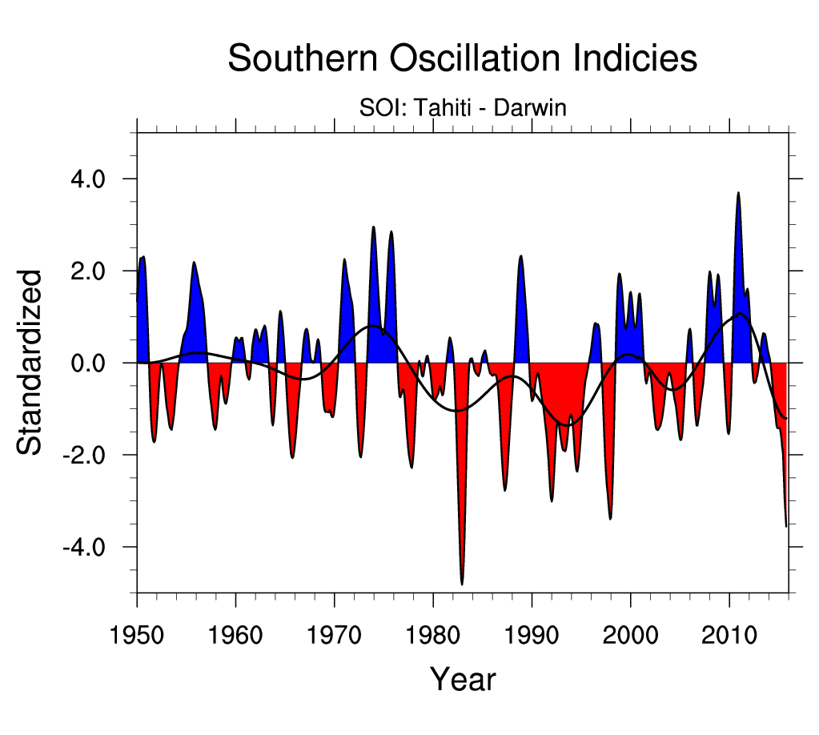
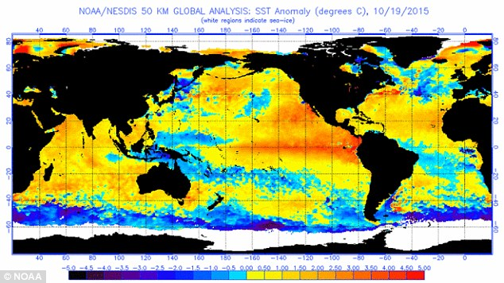
2015-2016 El Nino Season

Slide 9
Questions
Can machine learning techniques give us:
Autocorrelative patterns?
Insight on physical phenomenon?

Slide 10
Neural networks
“Universal Approximators”
Inspired by topology of human brain
Actively explored space of training algorithms to configure a network to approximate any function to arbitrary accuracy

Slide 11
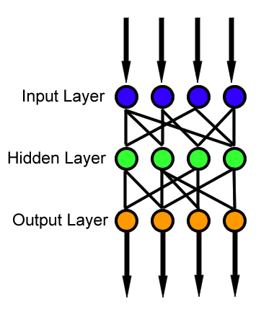
Feed-Forward Neural Networks
Input comes in through input layer, and information proceeds through to the output.
Connections from layer to layer have different strength and transfer functions
“Training” involves selecting how strong each connection should be.

Slide 12
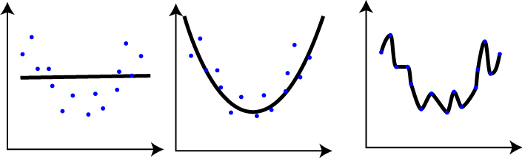
Issues
Search space very large and erratic compared to what common sense dictates
Strong potential of overfitting

Slide 13
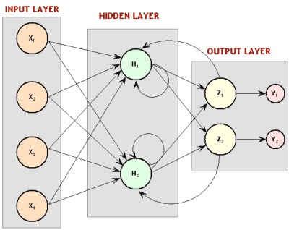
Recurrent Neural Networks
Trainable state machines
Universal approximation of processes, not functions
Nodes receive delayed signals from their past outputs
Much more suited for time series, and topology is much closer to reality.
Much less parameters; “recentness” built in.
Training and prediction done over a series, not over a data point.

Slide 14
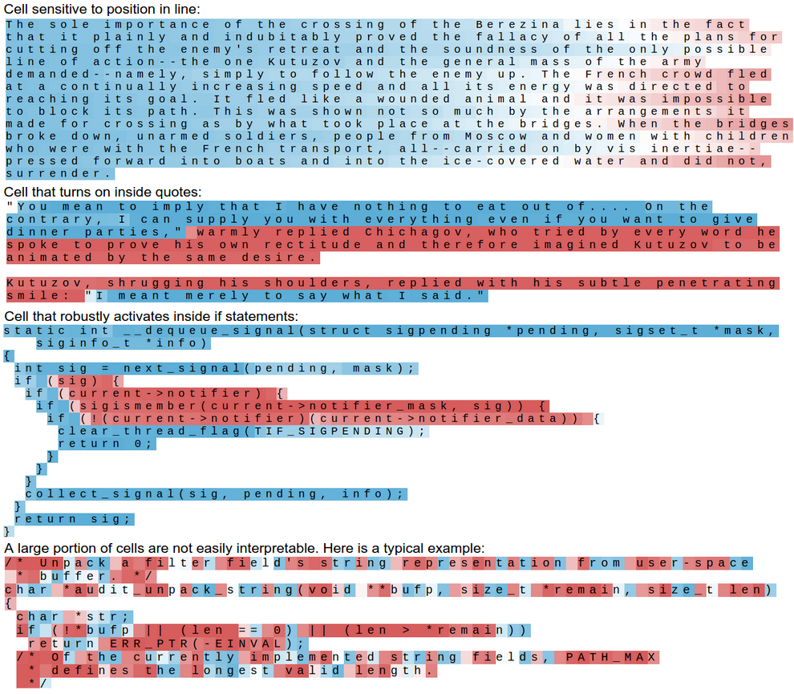
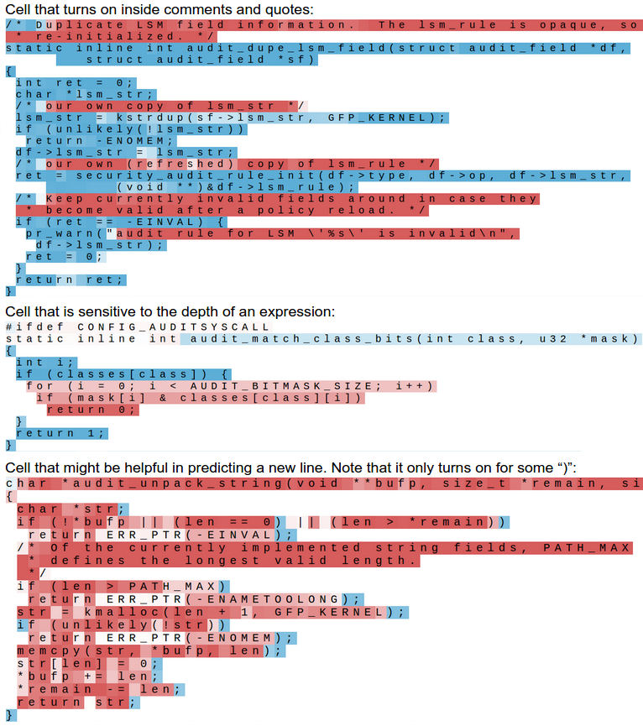
Ability to look at physical phenomenon
Andrej Karpathy, “The Unreasonable Effectiveness of Recurrent Neural Networks”
May 21 2015 http://karpathy.github.io/2015/05/21/rnn-effectiveness/

Slide 15
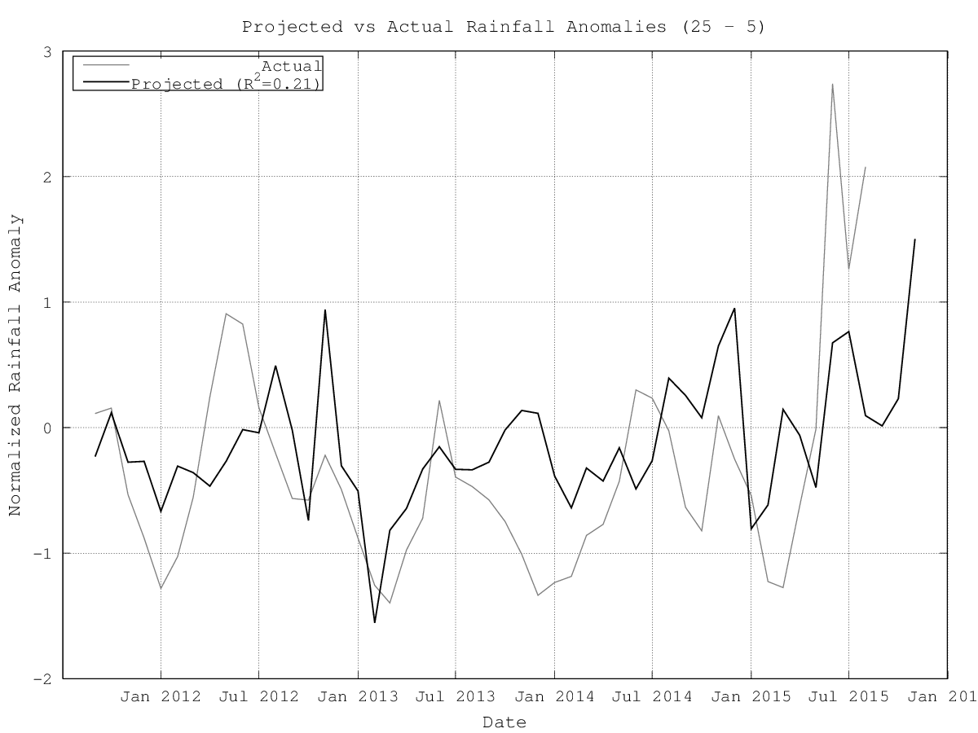
Initial Results
Initial results demonstrated correlation, making this avenue apparently worth pursuing.
Strong signs of overfitting.
Parameter reduction (and removing hidden layers) tended to improve results, but hit a wall.

Slide 16
Combatting Overfitting with Noise
Realization: we are trying to model a distribution, not a function.
Train with noise! Forces robustness.
Instant decreases in overfitting observed, and higher correlations.

Slide 17
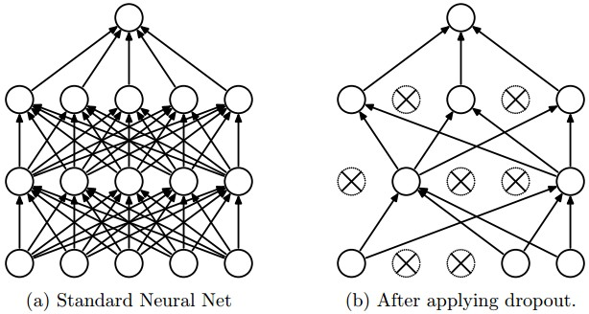
Combatting overfitting with Dropout
Train handicapped versions of networks in hopes that they find different features, and a way to work together despite missing neurons.
Inspired by sexual selection in evolution. Power in variation.
Overall effect is similar to running several networks at once, within only one network!

Slide 18
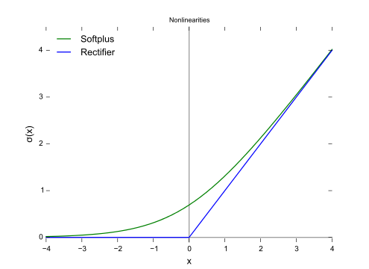
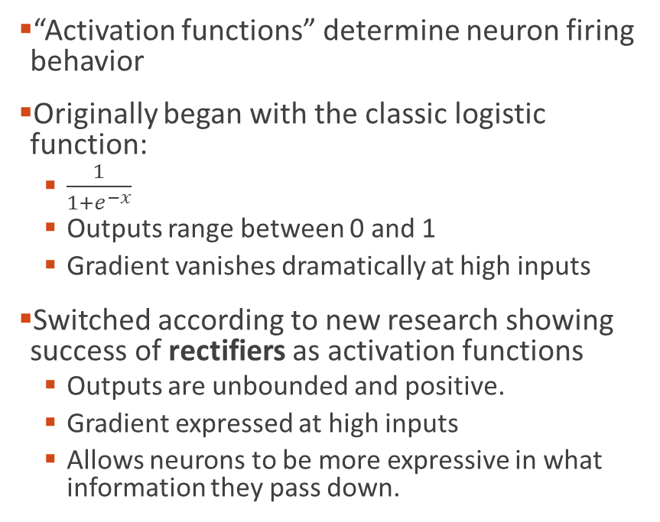
Increasing Expressivity with Rectified Linear Unit Activation Functions
“Activation functions” determine neuron firing behavior
Originally began with the classic logistic function:
$\frac{1}{1+e^{−x}}$
Outputs range between 0 and 1
Gradient vanishes dramatically at high inputs
Switched according to new research showing success of rectifiers as activation functions
Outputs are unbounded and positive.
Gradient expressed at high inputs
Allows neurons to be more expressive in what information they pass down.

Slide 19
Predicting the Future
Network is shaped to predict the next month of climate data/indices. But can it predict long-term?
“Leapfrogging into the future”.
Add noise to get confidence intervals.

Slide 20
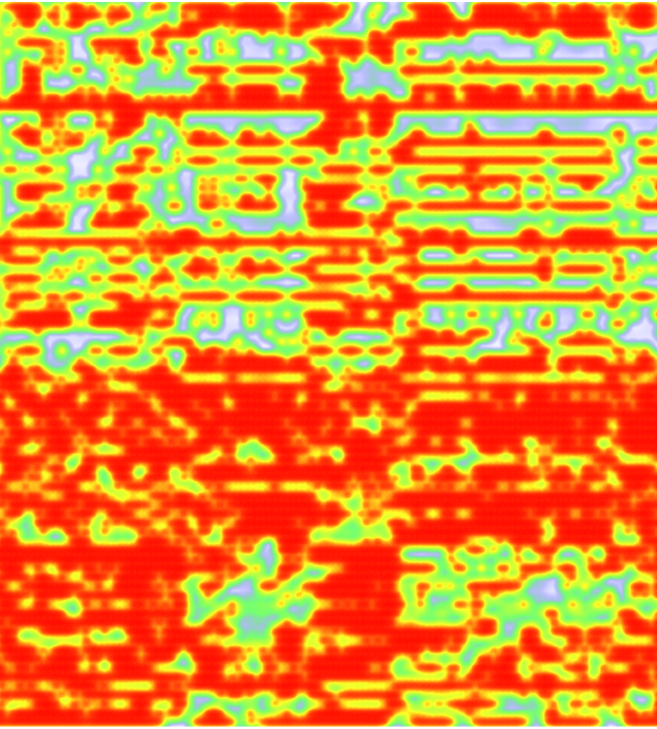
Node Activation Maps
Developing visualizations to peek into the mind of networks to find new potential phenomenon
Might yield:
Features that correspond to known or unknown physical phenomenon
Correlate with outside data and find any links
The ability to identify weak nodes or overly correlated nodes, and delete them: “brain surgery”
A way to gauge the health of a neural network.

Slide 21
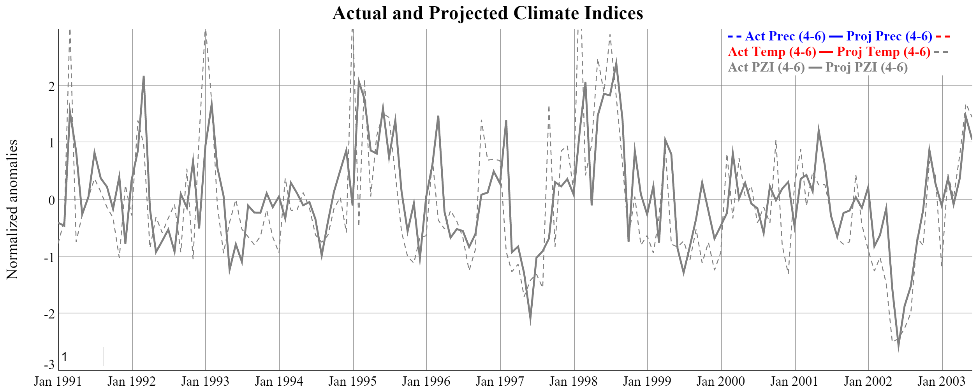
Training

Slide 22
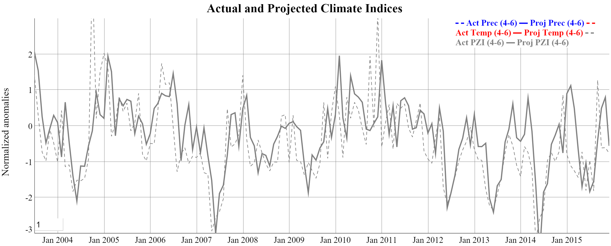
Validation

Slide 23
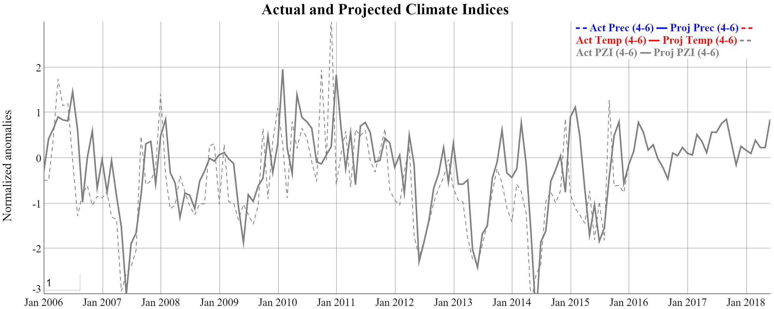
Prediction

Slide 24
Historical El Nino Z Indices
Season | Peak Anomaly | Peak Anomaly Month | Annual Anomaly
1957-1958 | 3.03 | April | 0.50
1982-1983 | 2.22 | April | 1.15
1997-1998 | 4.13 | February | 1.10
2009-2010 | 1.10 | January | 0.45
2015-2016* | 0.72 | March | 0.24
* Projected

Slide 25
2012-2016 Annual Z-Index Anomalies
Year | Annual Anomaly
2012 | -0.93
2013 | -1.30
2014 | -1.17
2015 | -0.85
2016* | 0.24
* Projected

Slide 26
Answers?
Definitely evidence of predictive power with high correlation (.5-.7 depending on the index being predicted).
Drought conditions always predicted accurately.
What’s in the future?
Looks like milder, average-level precipitation with drought indices moving towards non-drought.
Predicting a steady climb out of drought

